Slide 1

Abalone Age Predictive Modeling
Jose Luis Estrada
Nava Roohi
Ashutosh Singh

Slide 2

Introduction
Problem Statement:
Predicting age is complex and time consuming
Hypothesis:
Can predictive modeling and data mining be used to predict the age of the abalones?
Dataset and Attributes:
4,177 Observations & nine attributes
One numerical and eight categorical attributes
Ring +1.5 = Age
Notes:
Mentioning the process of identifying the age of the abalone and motivation briefly

Slide 3
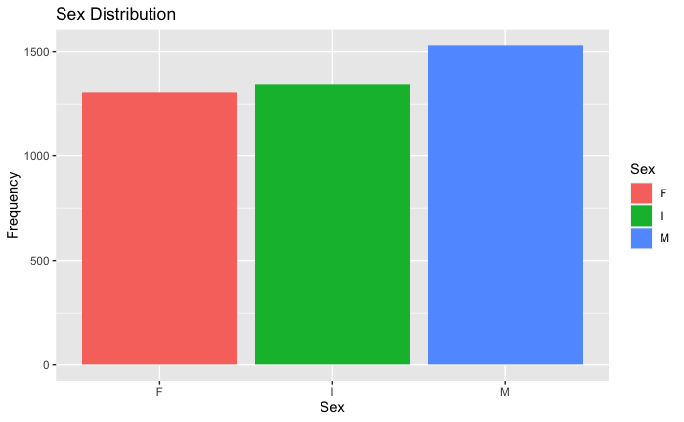
Exploratory Data Analysis

Slide 4
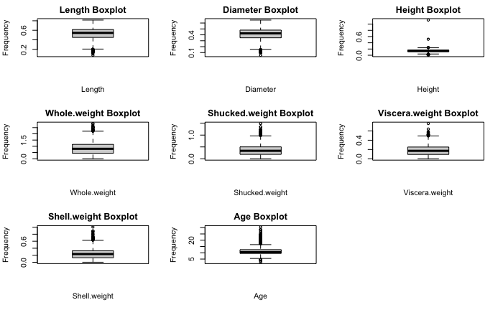
Exploratory Data Analysis
Distributions
Left skewness: Length and Diameter
Right skewness
Removing outliers
Height

Slide 5
Modeling and Conclusions
Model Comparison for Train Set
Models | RMSE | R^2
GLMNET | 2.198 | 0.5268
PLS | 2.193 | 0.5285
ENET | 2.193 | 0.5289
GLM | 2.193 | 0.529
MARS | 2.082 | 0.5751
KNN | 2.041 | 0.6
SVM | 2.001 | 0.6216
Model Comparison for Test Set
Models | RMSE | R^2
GLMNET | 2.313 | 0.5272
PLS | 2.312 | 0.5254
ENET | 2.312 | 0.5254
GLM | 2.313 | 0.5246
MARS | 2.246 | 0.5498
KNN | 2.364 | 0.5105
SVM | 2.272 | 0.5616

